Slide 1


Create an R Project using Version Control
BEFORE WE START!
2. Select your directory and add the following Git Repository URL:
https://github.com/ncypris/power_sim.git
3. All the files you need will be downloaded into your Project directory,
including these slides!

Slide 2
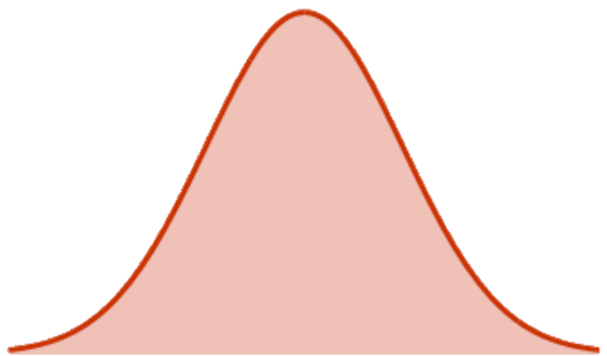



JRP WORKSHOP – 21/02/2021 Power Simulations: Going beyond G Power
Daniel Toribio-Flórez
Niklas Cypris

Slide 3
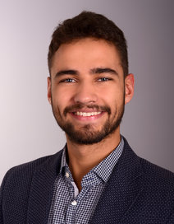
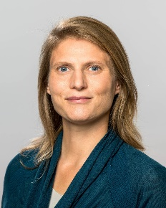
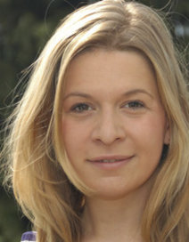

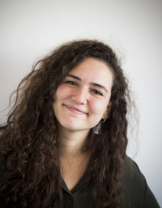
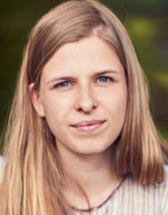


Time for Introductions!
Niklas Cypris
Background:
1st-year PhD student at Max Planck Institute for Research on Collective Goods (Bonn, Germany)
M.Sc. & B.Sc. in Psychology at University of Cologne (Germany)
Research interests:
Hate Speech & Misinformation
Social Identity & Morality
Open Science
Moral Courage Research Group
Daniel Toribio-Flórez
Background:
4th-year PhD student at Max Planck Institute for Research on Collective Goods (Bonn, Germany)
MRes in Social Psychology at Vrije Universiteit Amsterdam (Netherlands)
BSc in Psychology at Universidad Autónoma de Madrid (Spain)
Research interests:
Moral Courage and Intervention Behavior
Attitudes and Attitutinal Ambivalence
Open Science!

Slide 4
Overview
Theoretical Part:
Basics in Statistical Power and how to assess it! (≈ 15min)
The Logic of Power Simulation (≈ 15min)
Practical Part
Exercise 1: Your First Simulation! (≈ 30min)
Exercise 2: Power Simulation for one real study! (≈ 30min)
Q&A

Slide 5
Basics in Statistical Power and how to assess it!

Slide 6


Goal of Inferential Statistics

Slide 7
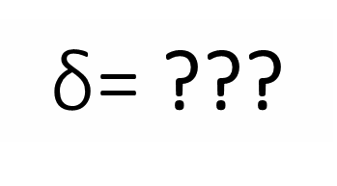
Goal of Inferential Statistics
$\text{δ}$= ???
d = .40

Slide 8
Two states of the world…
Our effect is FALSE at the population level
AVOID FALSE POSITIVES!
α = .05

Slide 9
Two states of the world…
Our effect is FALSE at the population level
AVOID FALSE POSITIVES!
α = .05

Slide 10
Two states of the world…
Our effect is FALSE at the population level
AVOID FALSE POSITIVES!
Our effect is TRUE at the population level
AVOID FALSE NEGATIVES!
α = .05
1 - β = .80

Slide 11
Two states of the world…
Our effect is FALSE at the population level
AVOID FALSE POSITIVES!
Our effect is TRUE at the population level
AVOID FALSE NEGATIVES!
α = .05
1 - β = .80

Slide 12
Why more control over False Positives versus False Negatives?
AVOID FALSE POSITIVES!
AVOID FALSE NEGATIVES!
α = .05
1 - β = .80

Slide 13
Why more control over False Positives versus False Negatives?
AVOID FALSE POSITIVES!
AVOID FALSE NEGATIVES!
For science, false positives are four times worse
than false negatives.
Neyman & Pearson (1933)
α = .05
1 - β = .80

Slide 14
AVOID FALSE NEGATIVES, AND INCREASE TRUE POSITIVES!
AVOID FALSE POSITIVES!
AVOID FALSE NEGATIVES!
α = .05
1 - β = .80

Slide 15
AVOID FALSE NEGATIVES, AND INCREASE TRUE POSITIVES!
AVOID FALSE POSITIVES!
α = .05
1 - β = .95

Slide 16

Why is important to increase the probability of TRUE POSITIVES?
Our effect is FALSE at the population level
Our effect is TRUE at the population level
p < .05
AVOID
FALSE POSITIVES
BE ABLE TO DETECT
TRUE POSITIVES

Slide 17
What does Statistical Power depend on?
Effect
Size
d for t-test,
rho (ρ) for correlation,
η_{p}² for ANOVA…
α
Usually α = .05
1 - β
Sample
Size (N)
Between-Subject Design
(i.e., number of participants)
Within-Subject Design
(i.e., number of observations)

Slide 18
Ways of Assessing Statistical Power
A PRIORI
POWER ANALYSIS
SENSITIVITY ANALYSIS
POWER-DETERMINATION ANALYSIS
INPUT:
Effect Size
Alpha
Desired Power
OUTPUT:
Sample Size
INPUT:
Sample Size
Alpha
Desired Power
OUTPUT:
(Minimum) Effect Size
INPUT:
Effect Size
Sample Size
Alpha
OUTPUT:
Estimated Power

Slide 19
When can we assess Statistical Power?
BEFORE
AFTER
A PRIORI
POWER ANALYSIS
DATA COLLECTION
SENSITIVITY ANALYSIS
SENSITIVITY ANALYSIS
POWER-DETERMINATION ANALYSIS
POWER-DETERMINATION ANALYSIS

Slide 20
When can we Assess Statistical Power?
BEFORE DATA COLLECTION
A PRIORI
POWER ANALYSIS
d = .20, α = .05, 1 – β = .80
N = 788
POWER-DETERMINATION ANALYSIS
d = .20, α = .05, N = 500
1 – β = .61
SENSITIVITY ANALYSIS
α = .05, N = 500, 1 – β = .80
d = .25

Slide 21
The Logic of Power Simulations

Slide 22
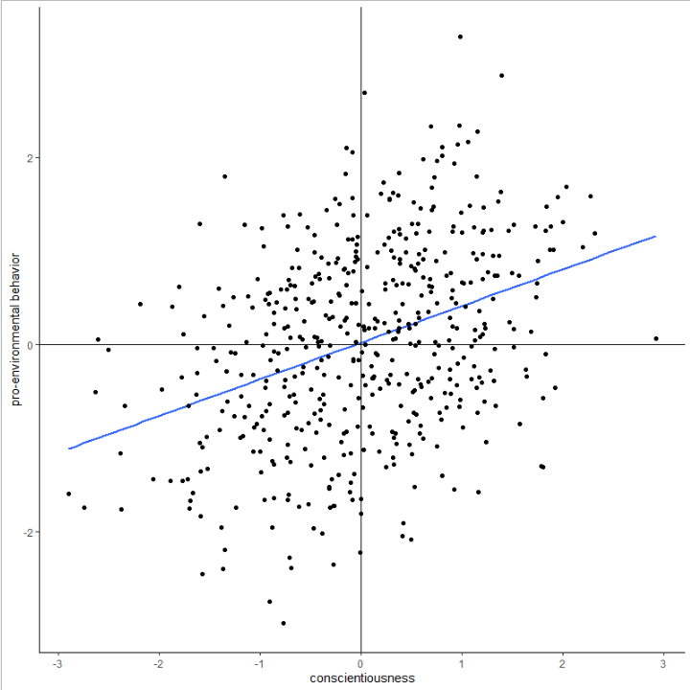
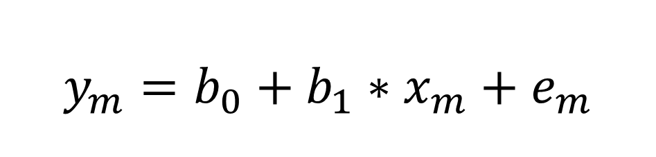
Regression Equation
$$y_{m}=b_{0}+b_{1}∗x_{m}+e_{m}$$

Slide 23
Regression Equation
$$y_{m}=b_{0}+b_{1}∗x_{m}+e_{m}$$

Slide 24
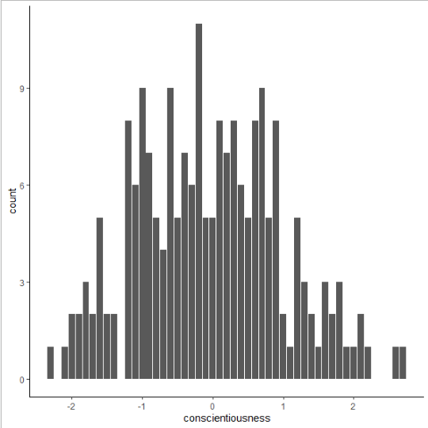
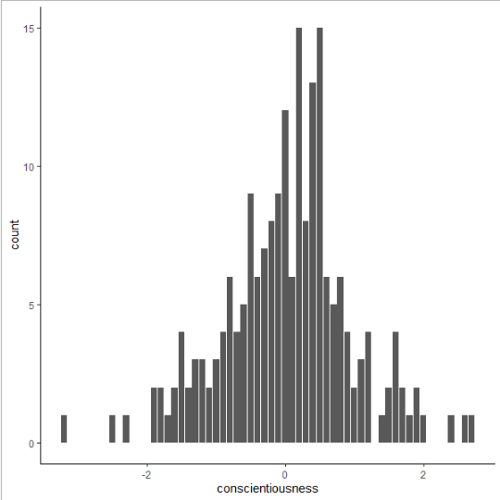
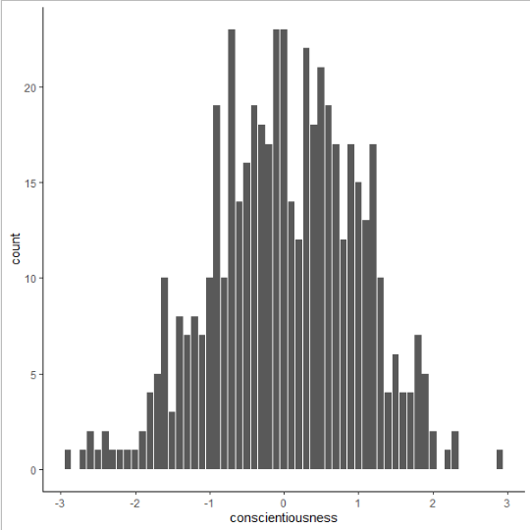
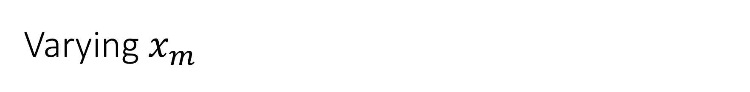
Varying $x_{m}$

Slide 25
Regression Equation
$$y_{m}=b_{0}+b_{1}∗x_{m}+e_{m}$$

Slide 26
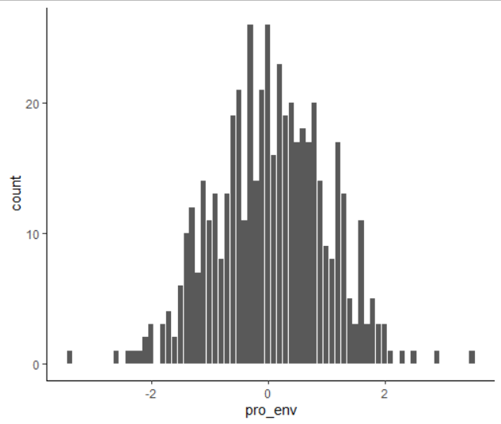
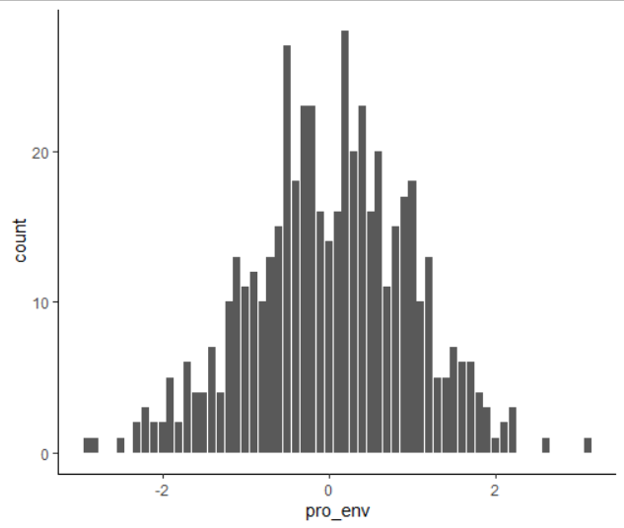
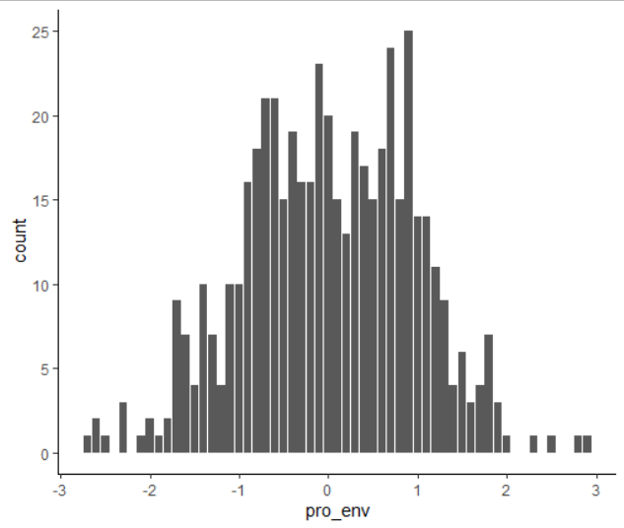

Varying $e_{m}$

Slide 27
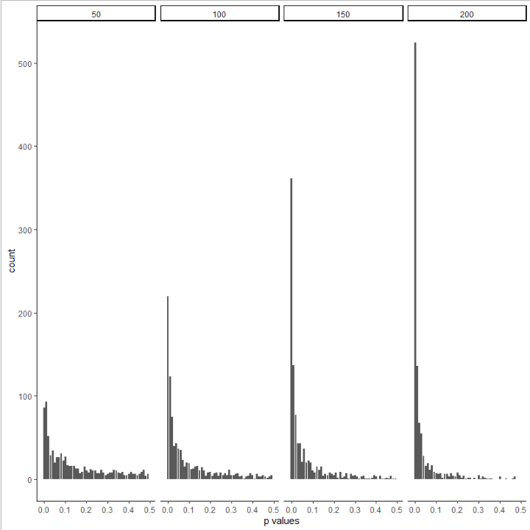
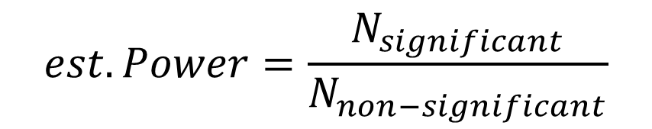
Lots of simulations
$$est. Power=\frac{N_{significant}}{N_{non−significant}}$$
0.30
0.52
0.67
0.82

Slide 28
Exercise 1: Your First Simulation!

Slide 29
Exercise 2: Power Simulation for one real study!

Slide 30
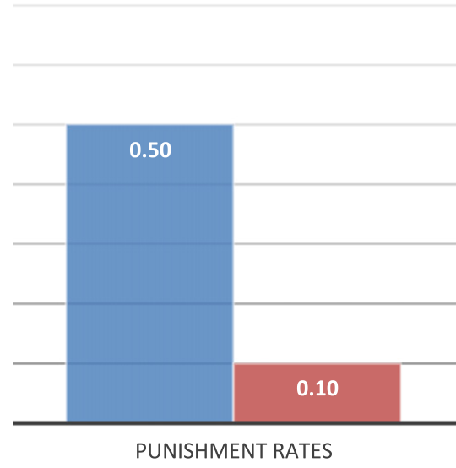

Background Information Balafoutas et al. (2014)
Punishment rates significantly decrease in the presence of counterpunishment.
Fisher’s exact test, two-tailed, p-value < 0.001
Is Balafoutas et al.´s analysis sufficiently powered?
Can we use their sample size for our research purposes?
If not, which sample size should we aim for?

Slide 31
Q&A

Slide 32
References and Resources:
Some references on Statistical Power:
Neyman, J., & Pearson, E. S. (1933, October). The testing of statistical hypotheses in relation to probabilities a priori. In Mathematical Proceedings of the Cambridge Philosophical Society (Vol. 29, No. 4, pp. 492-510). Cambridge University Press.
Giner-Sorolla, R., Carpenter, T., Lewis, N. A.,… Sodesberg, C. (2020). Power to Detect What? Considerations for Planning and Evaluating Sample Size. OSF. https://osf.io/d3v8t/
R packages Tutorials:
Paramtest: https://cran.r-project.org/web/packages/paramtest/vignettes/Simulating-Power.html
Power Simulations with Multilevel Models:
DeBruine, L. M., & Barr, D. J. (2019). Understanding mixed effects models through data simulation. PsyArxiv. https://doi.org/10.31234/osf.io/xp5cy
Green, P., & MacLeod, C. J. (2015) SIMR: an R package for power analysis of generalized linear mixed models by simulation. Methods in Ecology and Evolution. Vol. 7, No. 4, pp-493-498. https://doi.org/10.1111/2041-210X.12504
Power Simulations with Structural Equation Modelling (e.g., Mediational Analyses):
Wang, Y. A., & Rhemtulla, M. (2020). Power analysis for parameter estimation in structural equation modeling: A discussion and tutorial. PsyArxiv. https://doi.org/10.31234/osf.io/pj67b

Slide 33
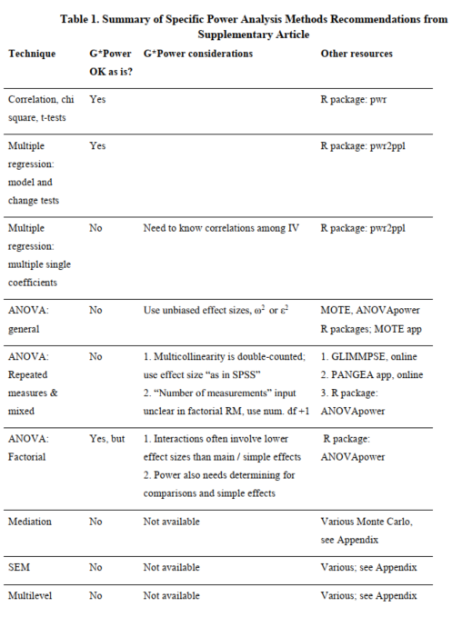
Giner-Sorolla, R., et al.(2020)

Slide 34

Thank you for attending today!
@
@
toribio-florez@coll.mpg.de
@dtoribio8
cypris@coll.mpg.de
@ncypris

